Slide 1
Court Management Services Year -In-Review 2011/2012
Presented by the Principal Executive Officer

Slide 2
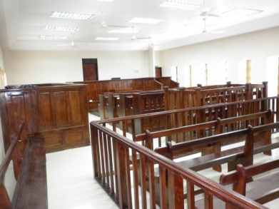
Background
Background

Slide 3
Establishment of CMS
The Court Management Services (CMS) was established as a independent entity by Cabinet Decision 31/08. This was done, in keeping with the intent to:
- strengthen Judicial Independence; and
- improve efficiency and effectiveness in the level of service delivery provided to the Courts.

Slide 4
Establishment of CMS
The Cabinet approved:
The appointment of a Principal Executive Officer (PEO) to head the CMS
That the head of the CMS be designated an Accounting Officer
Head reports to the Hon. Chief Justice and to the Parliament on accounting matters

Slide 5
Establishment of CMS
Cabinet Decision #31/08 gave approval for the transfer of the following functions that were previously carried out by the Ministry of Justice to the Courts:
Finance and Accounts
Internal Audit
Human Resource Management and Administration
Property (Facilities) management and maintenance
Information and Communication Technology Services
Customer/ Client Services

Slide 6
Establishment of CMS
Cabinet also approved in principle the transfer of other functions performed by Court functionaries but recognized the likelihood of necessity for legislative amendments to give effect to this intent.
Notes:
This include administrative functions carried out by law by resident magistrates, registrars and clerks of courts

Slide 7
Where we started
In June 2010, the PEO was recruited
At the time there was no evidence a CMS as a organization
The Courts Budget and that for the CMS was managed by the Ministry of Justice
The CMS posts that were transferred from the Ministry of Justice by way of the Establishment Order were still operating as part of the Ministry and continued to work as staff of the Ministry
Staff had not been oriented to the CMS as an independent entity under the purview of the Judiciary
The entity did not have an office location

Slide 8
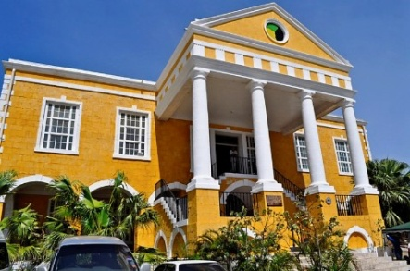
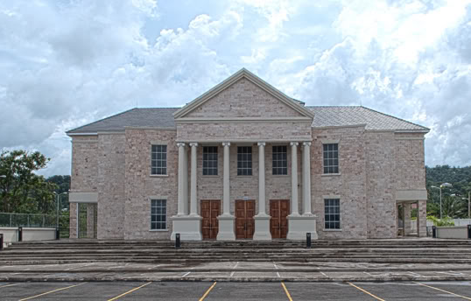
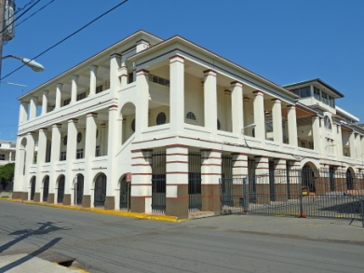
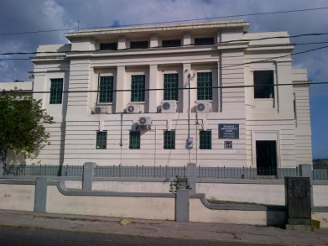
Where are we now a review of 2011/2012 Operationalization & major accomplishments

Slide 9
Where are we now
Evidence of a single organization as staff transferred from the MOJ has been transitioned into the CMS, new staff recruited and is operational. Staff compliment is currently at 70 persons.
There are 56 plants and over a 1000 officers in the Courts, that are managed and served by the staff.
Notes:
The MOJ still provide some transport management functions to the Courts especially with the judges and both entity’s still collaborate in the provision of administrative services though separated

Slide 10
Operationalization of key areas transferred
The CMS began operationalizing the transferred functions in November 2010 with human resources management and client services and communication.

Slide 11
Operationalization of key areas transferred
April 1, 2011 saw the CMS beginning to manage its’ budget and the budget for all the Courts independently.
Functions for internal audit were also operationalized by the CMS along with the budget.

Slide 12
Operationalization of key areas transferred
Information Communication and Technology
transferred and Operationalized
In October 2011 the ICT function was transferred from the MOJ’s MIS department to CMS’ ICT division.
Administration functions Operationalized
It became increasing challenging to effectively serve the Courts without the Administration unit of the Human Resource Management and Administration division being operationalized. This unit performs among other things, the core functions of procuring resources for the Courts.
While it remained as a shared- pool service with the MOJ, the limited staff available to serve the entire justice sector created a significant challenge for the CMS in fulfilling its mandate.
In October of 2011, the CMS incrementally began to operationalize this area.

Slide 13
Operationalization of key areas transferred
Property Management Division Operationalized
The Building Property Management Division was operationalized in February of this year. Maintenance and repairs of Court buildings are currently undertaken by the CMS.
The construction of new building still remain with the MOJ

Slide 14
Massive Reduction in Backlog of juror payments
During the 2011/2012 CMS undertook the task of reducing a massive backlog in Juror payments from 2008.
JMD $14.5 million in Juror claims submitted between 2008 to 2011 have been paid, currently, only JMD $1,400,000.00 of claims for that period remain outstanding.
These claims remain outstanding, mainly due to the placement of inaccurate TRN on claim forms or failure to affix the TRN on the claim forms.

Slide 15
Massive Reduction in Backlog on Mileage Payments
At the March 2012, mileage payments for Court staff were generally current, in that all claims received were paid, an improvement over an approximate six month arrears in April 2012.

Slide 16
Enhancing Client services
Customer Service Training Manual approved for rollout in the Courts. Customer Service Training will commence in the western region mid July 2012
Draft Customer Service Charter developed
First Chief Justice Annual Review held on Treatment of Child witnesses in Court
Protocol services provided to the Judiciary for local and overseas high Court judges, resident magistrates and visiting delegations from United Kingdom and Canada for ten separate events as per request of the Honourable Chief Justice
Brochure prepared to inform members of the public as to how to file claims in the Civil Court, serving as a juror, and how to file a divorce

Slide 17
Strengthened Human Resources Systems
Assessment of training needs in the Courts have been prepared for non-judicial staff
Training Manual on Leadership and Supervision prepared by Court staff with support from Canadian counterparts to train Court staff
Notes:
Request submitted to Post Operation Committee for the administrative staff for the preparation of juror summons for the Supreme Court

Slide 18
Organizational Structure Review Conducted
It was recognized very early in 2011/2012 that it would be difficult to effectively function with the limited Human Resources which the organization had at its disposal following the separation from the MOJ.
Attention was given to conducting an extensive organizational structure review.
A new structure for the CMS was finally approved in december of 2011.
To date – percentage of the approved structure is in place and an additional --- posts have been advertised.

Slide 19
Increase in Number of Resident Magistrates
During 2011/2012 the CMS operationalized
6 additional Resident Magistrates posts.
This was done in an effort to provide the Resident Magistrates Courts with additional human resource to effectively manage case loads.
There are now a total of 56 Resident Magistrates.

Slide 20
Training and Development for Judiciary, Magistracy & Court Administrative Staff
The CMS coordinated in collaboration with the Ministry of Justice Training Institute several workshops and training seminars for the Judiciary and the Magistracy.
These events have been facilitated through partnerships with the British High Commission, CUSO/VSO, National Judicial Institute (NJI Canada) and The Office of Federal Judicial Affairs (FJA Canada).
The workshops and seminars focused on a wide range of areas including:
1. Criminal Case Management.
2. Judicial Writing and Ethics.
3. The Treatment of Child Witnesses in Court.
4. Use of Oral Judgments.
6. Improving practices and procedures for sentencing.
7. Capacity Building in Records Management, Leadership and Client Services for Court Administrators.

Slide 21
Improving Case Flow Management
Case Management Implementation Plan has been prepared, reviewed by the Case Management Steering Committee and is being implemented.
Justice Undertaking for Social Transformation (JUST) Programme will be assisting with implementation of some components

Slide 22
Technological Upgrades to support Case Flow Management
Six scanners provided for the Registries at the Supreme Court to facilitate updating of information into JEMS towards improving case flow
Some 33 Computers purchased and installed in RM Courts
10 Medium Printers purchased and installed in RM Courts
9 Copiers purchased and installed in RM Courts and the Hanover Family Court
Network upgraded through structured data cabling at Supreme Court, Court of Appeal, Westmoreland Family Court, Clarendon RMC and Corporate Area Criminal Court.
Courts that were previously without email addresses, have now received such accounts, 100% of Courts currently have email accounts
Global internet access at all RM main Courts

Slide 23
new telephone system installed in courts
The Court of Appeal and the Supreme Court finally benefitted from a new telephone system . The Voice Over Internet Protocol (VOIP) Telephony Solution was installed in the third quarter of 2011/2012. The main features of the VOIP solution includes;
Calls from landlines to Digicel mobile phones which are in the ‘Courts’ Closed User Group”, and vice versa are free of cost.
Extension to extension dialing in place between the CMS, Supreme Court and the Court of Appeal
Direct inward dialing and direct outward dialing. Persons calling externally can call directly to an extension and persons can call externally from their extension

Slide 24
new telephone system installed in courts
The system was first installed in the Court of Appeal and Supreme Court, the CMS was later added to the system. It will later be extended to other Courts.
When implemented across all Courts the VOIP solution should result in a significant reduction in telephone costs for the Courts.

Slide 25
Supreme Court Website
On June 1, 2011 the CMS and the MOJ collaborate to launched an upgraded and improved Supreme Court website.
The purpose of the website is to provide information to the public and create an interface for Court users to access relevant information, such as Court lists and judgments.

Slide 26
Enhancing Maintenance of Court Buildings
Relocation Plan for the CMS has been successfully executed.
Proposal for the relocation of the Traffic Court has been prepared and shared with the Ministry of Justice
Preliminary Infrastructural Needs Assessment undertaken of Courts

Slide 27
Permanent Location identified in Justice Square
Potential location identified for the CMS but will require significant internal construction works.
A proposal has been submitted to the Ministry of Justice for acquiring the building as a permanent location for the CMS within Justice Square, hopefully within the next two years.

Slide 28
MOU with Food for the Poor
In March of 2012, A MOU was signed between the CMS and Food for the Poor (a non-profit NGO).
Under the MOU, Food for the Poor will provide assistance in the form of food items, equipment and supplies for the Children who attend the Kingston and St. Andrew Family Court Attendance Centre.

Slide 29
Other Court Related initiatives
Several projects facilitated at the Supreme Court and RM Courts to improve record storage, improve infrastructure etc. This include SC, Manchester, St. Catherine, Corporate Area Criminal.
Additional Imprests for Courts established/ operationalized to be able to support more effective management at the local level e.g. Kingston Drug Court.
Increases to current imprests have been requested from the Ministry of Finance
Several Court staff sensitized in strategic planning, accounting procedures and customer service
Additional storage facility acquired for Courts in the Corporate area
Proposal for the establishment of the Judicial Education Institute under the purview of the Chief Justice prepared

Slide 30
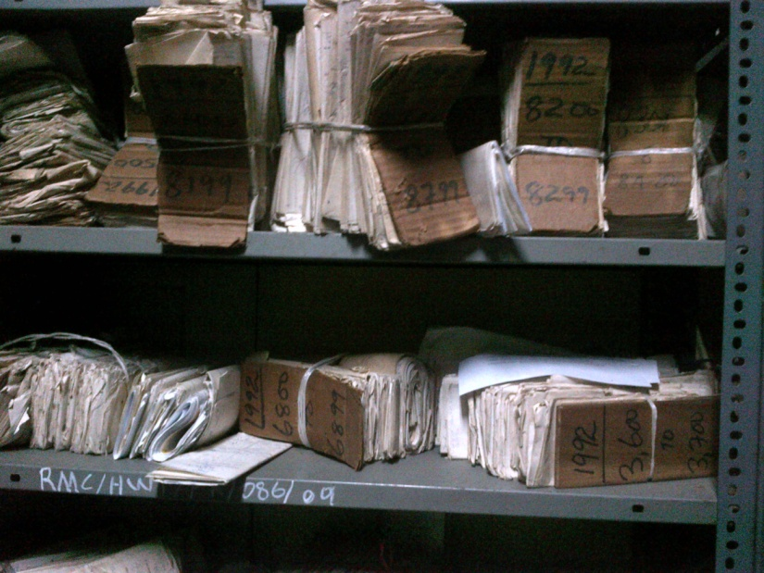
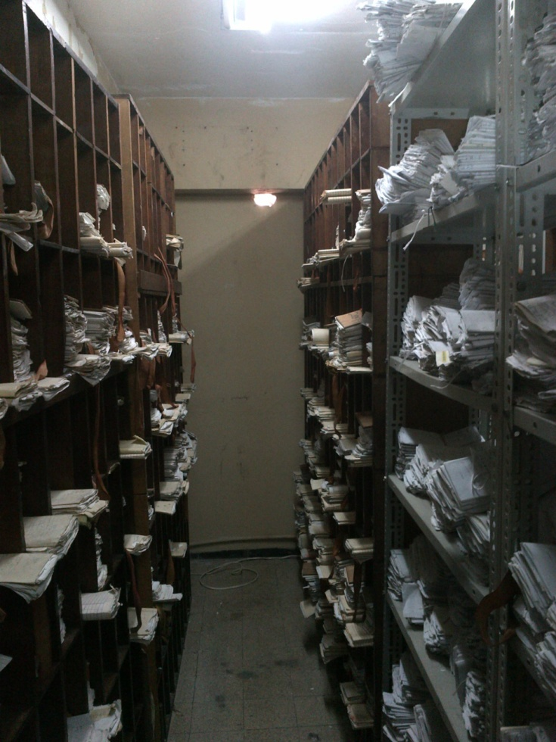
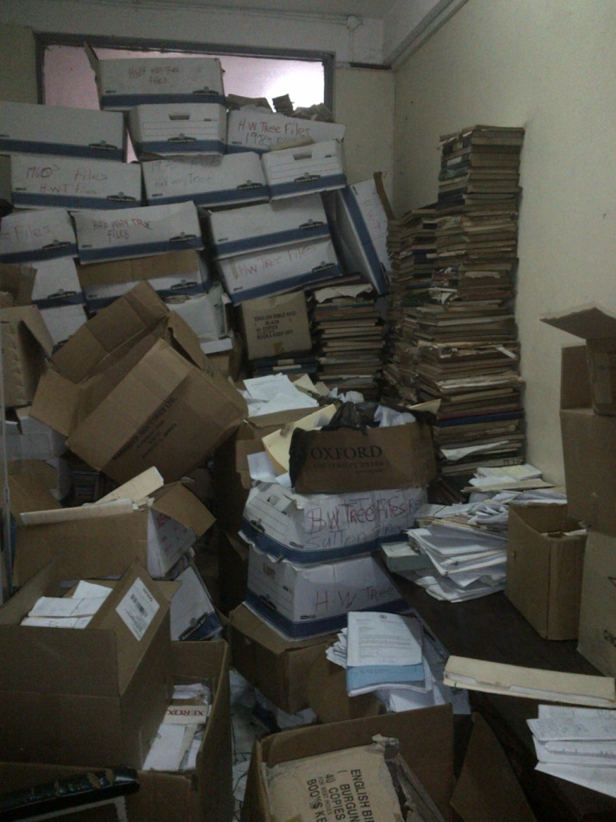
BEFORE

Slide 31
DURING

Slide 32
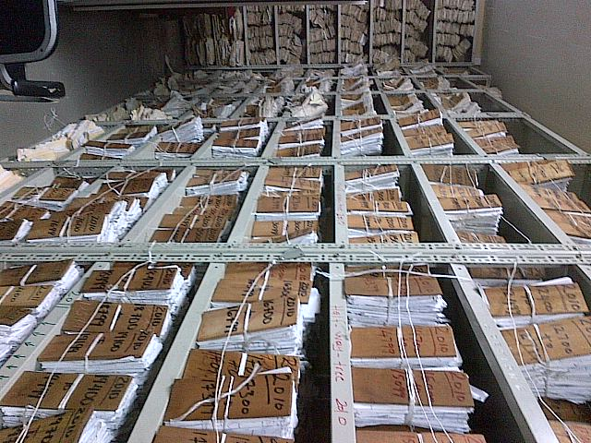
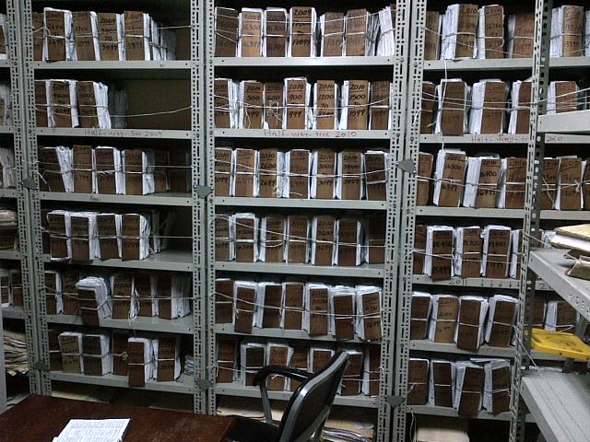
AFTER

Slide 33
Constraints
The operation of the entity preceded legislation that gave rise to several challenges including a lack of clarity in relation to aspects of the CMS governance framework
Issues regarding the scope of the CMS’s authority vis a vis the role and functions of the other posts within the Court structure. These posts are given administrative responsibilities in legislations which pre-date the CMS’s establishment.
Operational challenges due to inadequate cash flow
Severe staffing challenges
Even with a new organizational structure in place, limited office space and budgetary constraints caused the pace of recruitment to be delayed until the relocation in April 2012.
Notes:
Absence of Legislation has created a lack of clarity of the authority of the entity
CMS is expected to perform better than the MOJ with far less resources, this is not possible
Budgets woos affects procurement of needed supplies, example of media report on toner costing $8000

Slide 34
Major Plans for 2012/2013
Initiatives to improve Records Management in the Supreme Court and some RM Courts to support improved case flow management.
Commence Full Implementation of Judicial Enforcement Management System (JEMS) in Supreme Court
Expand WAN for increased internet interconnectivity between Courts
Leadership and Customer Service training and development for Court Staff
Increased access to information with launch of CMS website and re-vamping of Court of Appeal Website
Increased Public Education on Court processes and functions
Commence review of Court Organizational Structure
Further expansion of night courts

Slide 35
Major Plans for 2012/2013
It is anticipated that with some assistance from the JUST programme, steps will be taken to develop legislation for the CMS in this financial year.
Formal MOU in place with the MOJ to facilitate clarity of functions and roles between both entities especially with regards to functions shared by the Ministry of Justice and the CMS relative to the Courts
Improved overall performance with increased staffing capacity
The revamping of the Court of Appeal website.
Improving security to officers of the Courts in partnership with the Police

Slide 36
Thank You

